Slide 1
Making this resource work for you
Prior to teaching this lesson, please refer to the ‘Unit Overview and Planning Document’.
Further guidance on planning Science Mastery lessons can be found in the detailed planning guidance document.
Refer to the ‘notes’ section on each slide for useful information, including suggested expositions, pedagogical content knowledge, suggested questions, answers and more. Consider using presenter mode so you can see this guidance throughout the lesson.
The introduction slides can be adapted to suit your teaching style and the needs of your class.
Before the lesson, adapt the fix-it slide to address any misconceptions identified in the previous lesson’s exit ticket.
Choose from the suggested activities to suit your class. The intention is not that you complete all of these, but that you select those which ones are most appropriate for your students. It may be appropriate to further adapt activities for your students.
These lessons are designed to occupy approximately 1 hour. To adapt for a shorter or longer lesson duration we advise you to adapt the activity section accordingly.
Please consider using the final slide to send feedback about this lesson or examples of PowerPoints that you have adapted to our design team. Your feedback is used to improve Science Mastery for all of our teachers and students. We appreciate all suggestions and comments.
Thank you for reading!
The Science Mastery Team

Slide 2

Taking it Further: Corrosion and its Prevention
Answer the questions below.
What must be present in order for iron to rust?
On which electrode will a metal sometimes form during electrolysis?
How will the mass of an electrode change if a metal ion is discharged at that electrode?
Explain why alkali metals are stored under oil.
Write a word equation for the reaction of lithium and oxygen.
water, oxygen
The cathode (negative electrode)
The mass of the electrode will increase
Alkali metals are stored under oil to prevent them from reacting with oxygen in the air.
Lithium + oxygen → lithium oxide
Notes:
Big idea: Reactions Rearrange Matter
Foundation: Write a word equation for the reaction of sodium and oxygen to make sodium oxide.
Stretch: Write a balanced chemical equation for the reaction of sodium and oxygen to make sodium oxide (Na₂O)
Answers:
Foundation: sodium + oxygen → sodium oxide
Stretch: 4Na + O₂ → 2Na₂O

Slide 3
Taking it Further: Corrosion and its Prevention
Do Now:
What must be present for iron to rust?
On which electrode will a metal sometimes form during electrolysis?
How will the mass of an electrode change if a metal ion is discharged at that electrode?
Explain why alkali metals are stored under oil.
Write a word equation for the reaction of lithium and oxygen.
Drill:
Write a word equation for the reaction of sodium and oxygen to make sodium oxide.
Write a balanced chemical equation for the reaction of sodium and oxygen to make sodium oxide (Na2O)
Notes:
Answers:
Do Now:
1. water, oxygen
2. The cathode (negative electrode)
3. The mass of the electrode will increase
4. Alkali metals are stored under oil to prevent them from reacting with oxygen in the air.
5. Lithium + oxygen → lithium oxide
Drill:
sodium + oxygen → sodium oxide
4Na + O₂ → 2Na₂O

Slide 4
Corrosion and its Prevention
Read Now:
Shipwrecks from World War 2 are leaking pollutants into the World’s oceans. Over time, many of the iron materials in these ships corrode and wear away, which results in pollutants leaking out into the oceans. These pollutants include fuel which is carcinogenic (cancer-causing), explosives and chemical weapons. Many of these wrecks have been deemed too costly or dangerous to clean up. The scale of this problem is vast. During the Second World War alone, it is estimated that at least 20,000 ships were sunk around the world, with many more lost during other conflicts in the same period. The higher temperatures caused by global warming will mean that more of these pollutants will dissolve in the water, and as a result, will expose marine organisms to higher levels of toxic compounds.
Why are pollutants leaking out of World War 2 shipwrecks into the oceans?
List some of the pollutants that are leaking out.
What does the word ‘carcinogenic’ mean?
How many World War ships are estimated to have been sunk?
Why does the problem of global warming exasperate this situation?
Notes:
Exasperate a situation: To make a situation worse
Answers:
Over time, many of the iron materials in these ships corrode and wear away, which results in pollutants leaking out into the oceans.
Fuel, explosives and chemical weapons
Carcinogenic means cancer-causing
20,000
The higher temperatures caused by global warming will mean that more of these pollutants will dissolve in the water, and as a result, will expose marine organisms to higher levels of toxic compounds.

Slide 5

C4.2.13
03/10/2023
Taking it Further:
Corrosion and its Prevention
C4.2.1 PKR: Reactions of Metals
C4.2.2 Extracting Less Reactive Metals
C4.2.3 PKR: Ions, Ionic Bonding and Deducing Ionic Formulae
C4.2.4 (HT) Ionic Equations and Displacement Reactions
C4.2.5 (HT) Writing Half Equations
C4.2.6 (HT) Ionic Equations for the Reactions of Acids and Metals
C4.2.7 Introduction to Electrolysis
C4.2.8 Extracting Metals by Electrolysis
C4.2.9 Electrolysis of Molten Ionic Compounds
C4.2.10 Electrolysis in Solutions
C4.2.11 RP: Electrolysis of Aqueous Solutions
C4.1.12 RP: Electrolysis of Aqueous Solutions
C4.1.13 TIF: Corrosion and its Prevention
C4.2.14 (HT) Obtaining Raw Materials
C4.2.15 Recycling Metals
C4.2.16 Feedback Lesson
Notes:
Big Idea: Reactions Rearrange Matter
Suggested Hook:

Slide 6

Following this lesson, students will be able to:
Define corrosion
Describe some methods used to prevent corrosion
Explain how electroplating is carried out
Key Words:
corrosion
sacrificial metal
electroplating
Notes:
Guidance:
See unit overview document and planning guidance to see how these objectives are typically assessed at GCSE, including examples of what students should be able to do following this lesson.
Planning for different needs:
The learning objectives given on this slide are suggested based on the most common requirements for exams, however they can be adapted based on the needs of different classes.
For best practice, the unit preparation booklet should be used to determine the appropriate focus of lessons within the unit.
While it is not possible to explicitly split content into levelled grades, we recommend that lesson objectives can be classified as critical, core or stretch.
Critical: the content or skill is essential for all students to be able to progress.
Core: the content or skill is important for students to progress, but other opportunities may be available to revisit it.
Stretch: the content or skill may not be essential for all students but is important for students aiming for the highest grades.
Key skill: this is a crucial skill being developed in this unit as part of the skill mapping
C4.2.13 Lesson Objectives:
Critical: Define corrosion
Critical: Describe some methods used to prevent corrosion
Core: Explain how electroplating is carried out

Slide 7
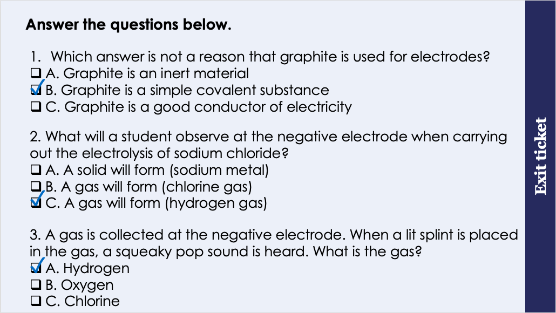
This is the fix-it portion of the lesson
The fix-it is an opportunity to respond to gaps in knowledge, especially those identified by the previous lesson’s exit ticket.
The teacher should customise this slide as needed, to facilitate
reteach, explanation, demonstration or modelling of ideas and concepts that students have not yet grasped or have misunderstood.
practise answering specific questions or of key skills.
redrafting or improving previous work.
Notes:
Purpose: to spend time on any gaps identified in previous learning from exit ticket feedback.
Fix-it guidance from previous exit ticket:
Q1. Answer: B
If students answer A or C, they are unable to explain why graphite is a suitable material to use for electrodes. To fix-it, reiterate the advantages of using graphite in electrolysis with reference to these properties.
Q2. Answer: C
If students answer A, they have recognised that sodium usually forms at the negative electrode, however they have not realised that in this example hydrogen would be formed instead. To fix-it, explain to students how to determine the ion discharged where there is more than one positive ion in a solution. Give students some example solutions to practice identifying the discharged ion.
If students answer B, they have correctly identified the substance that would form at the positive electrode, not the negative electrode. To fix-it, explain to students how to determine the ion discharged at each electrode. Give students some example solutions to practice identifying the ion discharged at the anode and cathode.
Q3. Answer: A
If students answer B or C, they are unable to identify gases using the gas tests. To fix-it, demonstrate the gas tests and ask students to complete a table that summarises each.

Slide 8
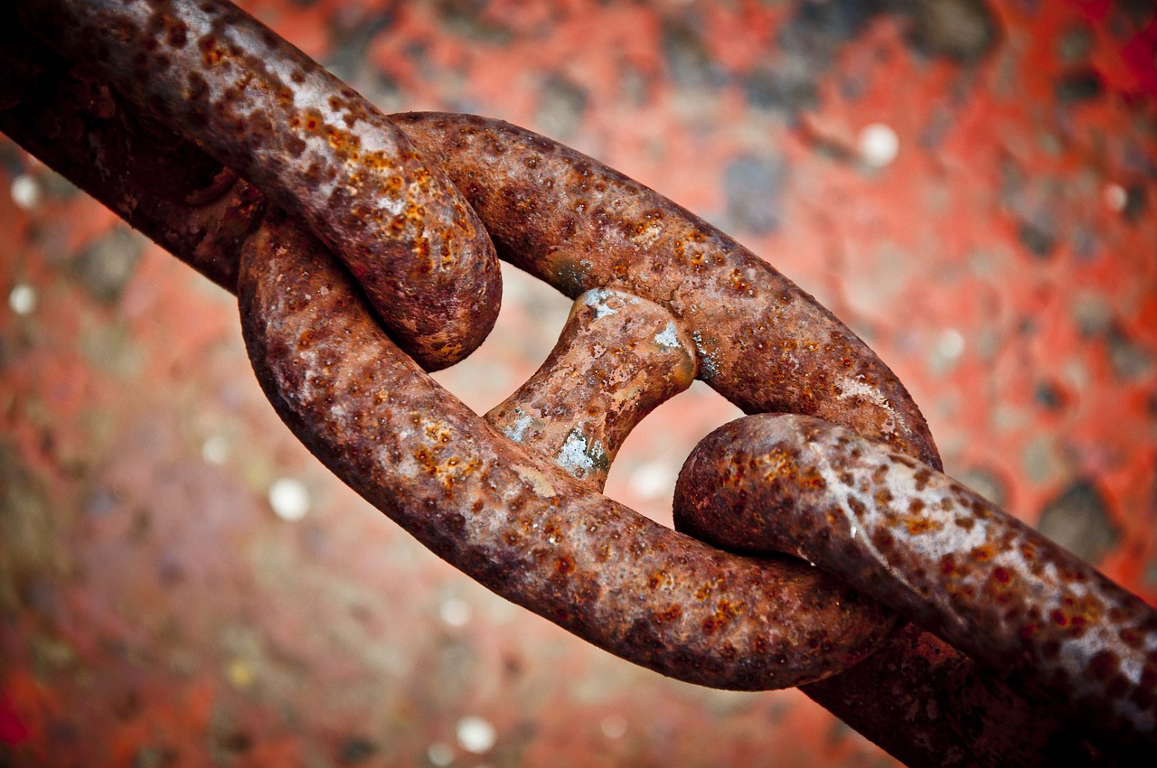
Corrosion
Corrosion is the destruction of materials by chemical reactions with substances in the environment.
Rusting is an example of corrosion.
For iron to rust, water and oxygen must be present.
Corrosion can be prevented by putting a barrier on the surface of the metal
Notes:
Exposition type: Explanation
In preparation for this lesson, you can place an iron nail in water and leave it exposed to the air for a week to show rust forming. It’s also a good idea to have a control experiment to compare it to where the nail has access to oxygen but no water, or water but no air (use boiled water that fills a sealed test tube to the top)
Model teacher exposition:
Today we are learning about corrosion. You have already encountered this work in Key Stage 3, when we talked about rusting.
Firstly, lets define the word corrosion. Corrosion is the destruction of materials by chemical reactions with substances in the environment.
You may want to ask students to repeat this back to you as a choral response.
Often, metals, especially the more reactive metals, will react with substances in the environment around them, and this causes them to corrode.
You might remember we touched in this topic in year 9 when we studied the alkali metals. The alkali metals react readily with oxygen. So, how do we store them to prevent corrosion? We store them under oil. This means that no oxygen can come in contact with the metal. The oil forms a sort of barrier between the metal and the oxygen which prevents that corrosion.
Use a piece of sodium to demonstrate this.
See when I cut this soft sodium metal the inside is shiny silver. Very quickly if I leave this out in the air, it will react with the oxygen and turn a dull colour. This is the sodium oxide layer forming on the surface.
Rusting is a similar process. The water and oxygen react with the iron to form iron oxide. Iron oxide has different properties to iron metal. It is much less strong for example. It isn’t malleable like a metal is. It is a rusty orange-brown colour, so we can easily see when it forms on the iron surface. Rust is not a welcome sight on many iron products, because if these different properties. It often means that the item is no longer for for use. For example, rusting on the hull of ship means the structure is weakened and that can result in leaks.
Aluminium typically has an oxide coating that prevents the metal from corroding.
Image source: Pixabay

Slide 9

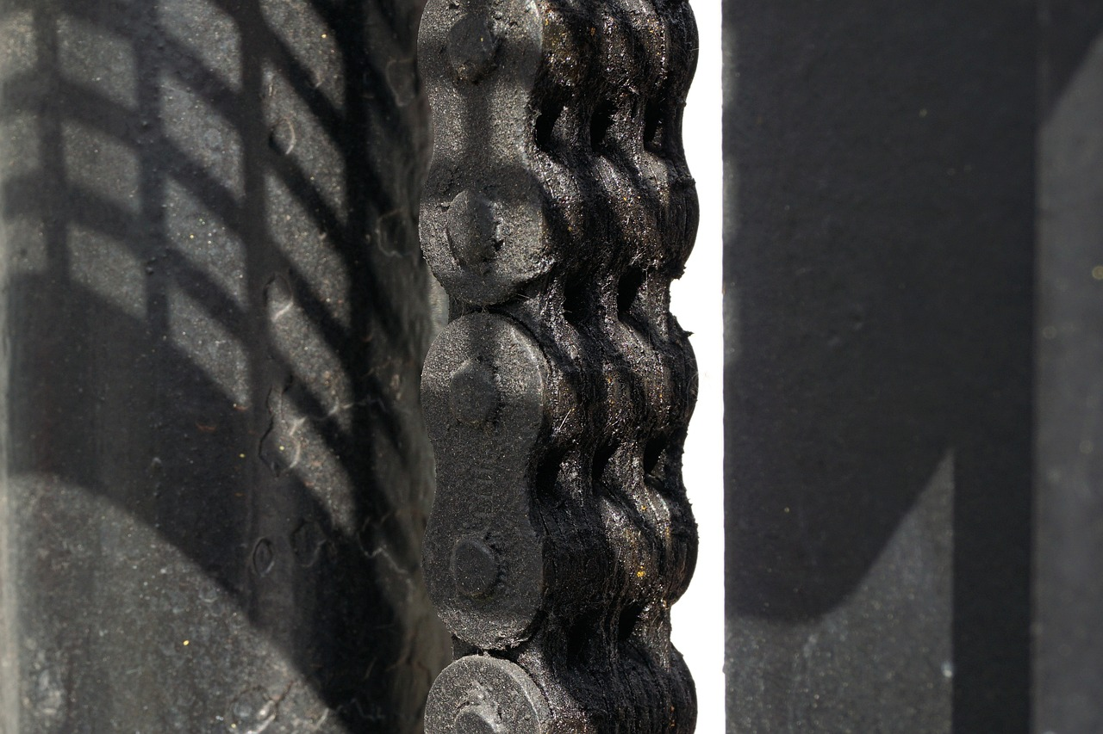
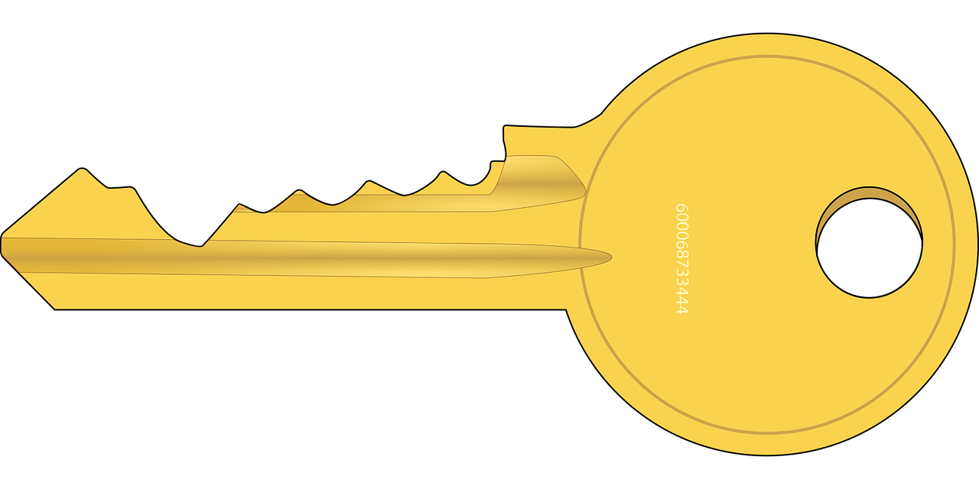
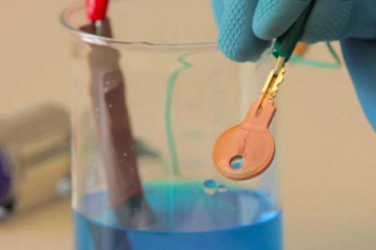
Preventing corrosion
Corrosion can be prevented by painting, greasing or electroplating.
+
Notes:
Exposition type: Demonstration
It is useful to retain the electrodes from the required practical in the precious lesson which have been coated with copper. Otherwise, a photo of this is fine.
Model teacher exposition:
Let’s think about how corrosion can be prevented.
Remember the example of the alkali metals in oil. Preventing corrosion usually involves having some kind of barrier between the metal and the environment, or the substance it would react with.
Picture 1: Painting example
Picture 2: Greasing example (bicycle chain)
Picture 3: Electroplating example
Think back to our electrolysis investigation last lesson. Hand out the cathodes to each group which have copper deposited on them.
You can see that using electrolysis, we can cause a coat of metal to form on the cathode.
In this case, we used copper (II) chloride solution, so a thin layer of copper metal deposited onto the cathode.
Now, if we replaced that cathode with a metal object, such as the key you can see in this image, then we could coat that key with a thin layer of copper. This coat of copper can act as a barrier to prevent that key from corroding. We say that the new layer of metal on the outside is the sacrificial metal. What does the word sacrificial remind you of? Sacrifice. Exactly, so you can think of it like the sacrificial metal sacrifices itself to save the metal underneath! Dual code the words ‘sacrificial metal’ on the board, next to ‘metal that forms a protective barrier’
You might notice that some items in shops, like jewellery, say ‘silver plated’ or ‘gold plated’. This just means that the object itself is made of a different metal, but has had gold or silver electroplated on the outside. As gold and silver are unreactive metals, they are unlikely to corrode, and so it protects the object, and keeps an attractive shiny appearance.
Use the practical guide to demonstrate the process of electroplating.
Sometimes, when electroplating, not all of the metal is deposited onto the cathode. It might fall into the solution or appear as a little pile of solid on the floor of the beaker.
How might I obtain that metal to measure its mass? Filter the solution, wash and dry the residue, weigh it.
Then if I add this mass to the increase in mass of the cathode, I can find the total mass of metal produced!
Images source: Pixabay

Slide 10

Is this correct?
Rusting is the destruction of any metal by chemical reactions with substances in the environment
Notes:
Answer:
This is incorrect. It is a misconception to say that any metal can rust. Rusting refers to the corrosion of iron specifically.
Suggested guidance:
Talk tasks can be used in a variety of ways to suit the particular needs of the students you are teaching. Through exchanging views with others, students develop their understanding of the science beyond what could be achieved individually.
Science classrooms that successfully integrate talk have the following features:
Science talk is a regular feature of lessons and is woven into classroom activities.
Students are paired or grouped strategically by the teacher to ensure productive interaction. This might take into consideration the students’ proficiency of the English language, how encouraging they might be to peers and their attainment in the topic. It’s a good idea to consider these pairings in the class seating plan.
Students are encouraged and supported to talk, but are not forced to talk.
The teacher should take on the role of a facilitator, engaging with conversations where necessary and encouraging or steering the conversation where needed.
Students are encouraged to use the language they have to express their ideas (e.g., everyday language, imperfect English, native language), but also to incorporate science specific terminology where this is more accurate or has been taught.
6. Scientifically inaccurate ideas are not dismissed by the partner or teacher; open discussion and further investigation are relied on to help students construct ideas that support them to progress in their scientific understanding.
7. Guidelines for behaviour during talk tasks are explicit and frequently reviewed. Rules for students might be:
Listen carefully to your partner
Take turns talking.
Speak one at a time, without interrupting.
Politely agree or disagree and explain why.
Politely point out if your partner has used a scientific word incorrectly, if they have explained the science incorrectly, or if there is a more accurate way to describe something.
If confused, ask questions.
Stay focused on the discussion topic.
Respond to one another.

Slide 11
Drill
What is corrosion?
What is the corrosion of iron called?
What 2 substances must be present for the corrosion of iron to occur?
What is the product of the corrosion of iron?
List 3 methods used to prevent corrosion in metals.
What process is used to electroplate a metal.
Which electrode is electroplated?
What separating technique is used to obtain metal from the solution which hasn’t attached to the cathode?
What property of metals make them suitable to use as an electrode?
Notes:
Purpose: This is a knowledge drill. The purpose of this is to check that the critical knowledge is secure before pupils move onto independent practice.
Suggested guidance: There are a range of ways this could be done depending on time and ability range of the class:
Mini whiteboards
As full sentences in exercise books
As short answers in exercise books
In the pupil workbook
As pair talk
As cold call

Slide 12
Drill answers
Corrosion is the destruction of materials by chemical reactions with substances in the environment.
The corrosion of iron is called rusting
For rusting to occur, water and oxygen must be present
iron oxide is the product of the rusting of iron
Painting, greasing and electroplating can be used to prevent corrosion of metals
Electrolysis is used to electroplate a metal
The cathode is always electroplated
Filtration is used to obtain metal from the solution
Metals are suitable to use as electrodes as they are good conductors of electricity
Notes:
Purpose: This is a knowledge drill. The purpose of this is to check that the critical knowledge is secure before pupils move onto independent practice.
Suggested guidance: There are a range of ways this could be done depending on time and ability range of the class:
Mini whiteboards
As full sentences in exercise books
As short answers in exercise books
In the pupil workbook
As pair talk
As cold call

Slide 13

I: Electroplating a cathode
A student plotted this graph as she investigated the electrolysis of copper (II) sulphate solution.
20
(a) Describe the change in mass of the cathode (1)
15
The mass of the cathode is increasing.
(b) Predict the mass of the cathode after 240 seconds (1)
8 g
Mass of cathode (g)
(c) Some of the copper produced did not stick to the electrode, but sank to the bottom of the beaker. Suggest how the student obtained the measurement at 180 seconds. (3)
10
5
filter the solution to obtain all of the copper
wash and dry the copper (residue)
weigh the copper collected
Add to the increase in mass of the electrode
0
0
60
120
180
240
Time (s)
Notes:
https://en.wikipedia.org/wiki/Graph_paper#/media/File:Graph-paper.svg

Slide 14
We: Electroplating a key
A student plotted this graph as she electroplated a key with gold.
40
(a) State the mass of the key at the start of the electrolysis process (1)
30
The mass of the key was 10 g.
(b) Predict the mass of the key after 8 minutes (1)
26 g
Mass of key (g)
(c) Some of the gold produced did not stick to the key, but sank to the bottom of the electrolysis container. Suggest how the student obtained the measurement at 6 minutes. (3)
20
10
filter the solution to obtain all of the gold
wash and dry the gold (residue)
weigh the gold collected
Add to the increase in mass of the key
0
0
2
4
6
8
Time (min)
Notes:
https://en.wikipedia.org/wiki/Graph_paper#/media/File:Graph-paper.svg

Slide 15
You: Electroplating a cathode
A student plotted this graph as she investigated the electrolysis of silver chloride solution.
10
(a) Describe the change in mass of the cathode (1)
7.5
The mass of the cathode is increasing.
(b) Predict the mass of the cathode after 120 seconds (1)
10 g
Mass of cathode (g)
(c) Some of the silver produced did not stick to the electrode, but sank to the bottom of the beaker. Suggest how the student obtained the measurement at 90 seconds. (3)
5
2.5
filter the solution to obtain all of the silver
wash and dry the silver (residue)
weigh the silver collected
Add to the increase in mass of the cathode
0
0
30
60
90
120
Time (s)
Notes:
https://en.wikipedia.org/wiki/Graph_paper#/media/File:Graph-paper.svg

Slide 16
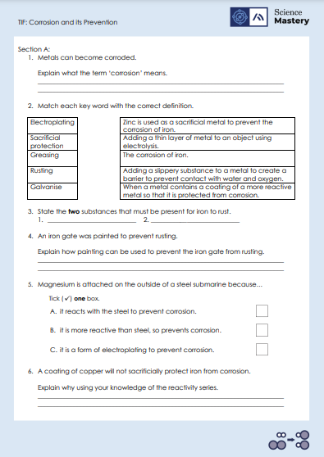
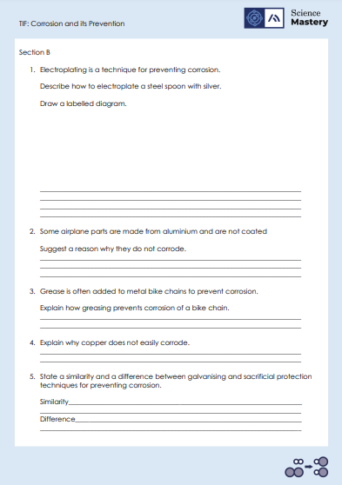
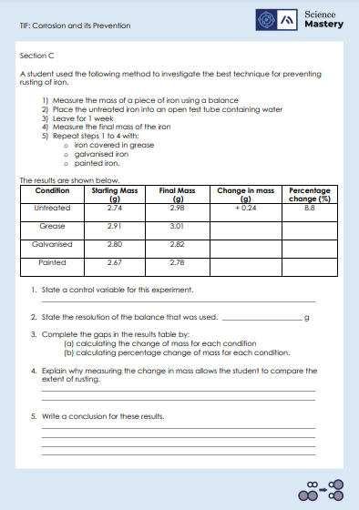
Activity

Slide 17
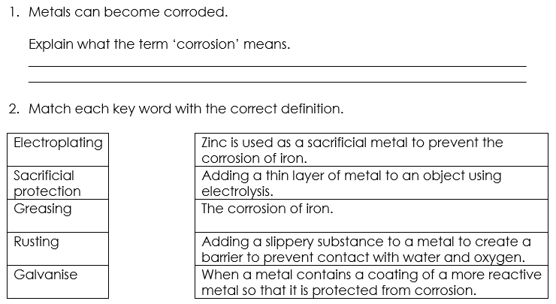
Answers – Section A
The destruction of materials by chemical reactions with substances in the environment.

Slide 18
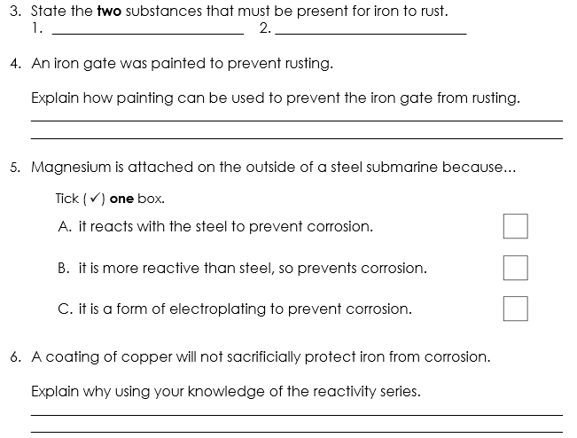
Answers – Section A
Oxygen
Water
Painting prevents water and oxygen from contacting the iron gate so rusting cannot happen.
✓
Copper is less reactive than iron so cannot be used for sacrificial protection

Slide 19
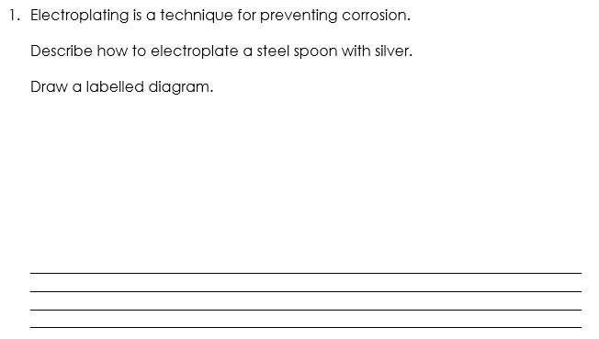

Answers – Section B
Power supply
+
Silver electrode
Steel spoon electrode
Silver nitrate solution
Silver ions in silver nitrate solution are cations that move towards the cathode where they are reduced and discharged as silver metal.
This leaves a coating of silver metal on the spoon.
Notes:
Alternative answer: other silver ionic compound salutation would also be acceptable

Slide 20
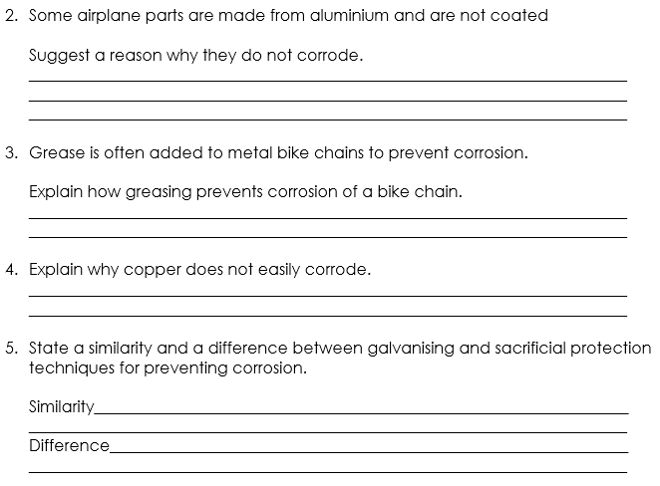
Answers – Section B
Aluminium is so reactive that it has already reacted with oxygen so therefore has a protective covering of aluminium oxide.
Grease is insoluble so prevents any water or oxygen from contacting the metal bike chain.
Copper is relatively unreactive so will not react with substances in the environment and corrode.
Both use a more reactive metal to prevent corrosion
Galvanising is specific to the use of zinc as the sacrificial metal, whereas any reactive metal can be used in sacrificial protection.

Slide 21
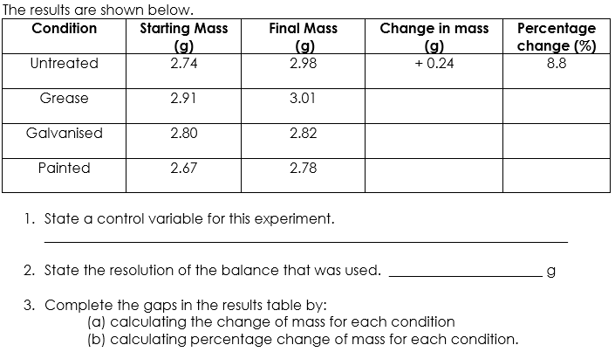
Answers – Section C
+ 0.10
3.4
+ 0.02
0.7
+ 0.11
4.1
Volume of water, temperature, drying the iron before weighing
0.01

Slide 22
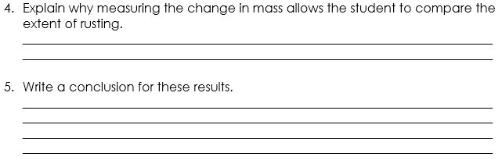
Answers – Section C
Rust is (hydrated) iron oxide which has a greater mass than pure iron, this means that the greater the mass, the greater the extent of rusting.
The galvanised iron is the most effective technique at preventing rusting in this experiment.
This is shown in the results because the galvanised iron only had a 0.7% increase in mass compared to an 3.4% for greasing and 4.1% for painting.
Notes:
Alternative answers: for the conclusion, any valid manipulation of data from the results table would be accepted.

Slide 23
Answer the questions below.
What is corrosion?
A. The destruction of materials by chemical reactions with substances in the environment
B. The destruction of iron by chemical reactions with substances in the environment
C. The destruction of metals by chemical reactions with substances in the environment
✓
2. Which option is not a method to prevent the corrosion of metals?
A. Electroplating
B. Electrolysis
C. Painting
✓
3. Which technique can be used to separate metal from a solution?
A. Filtration
B. Distillation
C. Fractional distillation
✓
Notes:
Q1. Answer: A
If students answer B or C, they cannot recall the exact definition for corrosion, and may be confusing this with rusting. To fix-it, show students various examples of corrosion and ask them to recite this definition.
Q2. Answer: B
If students answer A or C, they cannot recall the methods used to prevent corrosion, and may be confusing electroplating with electrolysis. To fix-it, ask students to explain how each method prevents corrosion by forming a barrier between the material and the environment.
Q3. Answer: A
If students answer B or C, they cannot recall how a solid metal can be separated from the liquid solution. To fix-it, ask students to summarise each of these separation techniques with a labelled diagram, and to give an example of a solution that can be separated with each.

Slide 24
Lesson C4.2.13
What was good about this lesson? | What can we do to improve this lesson?
Send us your feedback by clicking this link
or by emailing sciencemastery@arkonline.org
Thank you!

